Slide 1
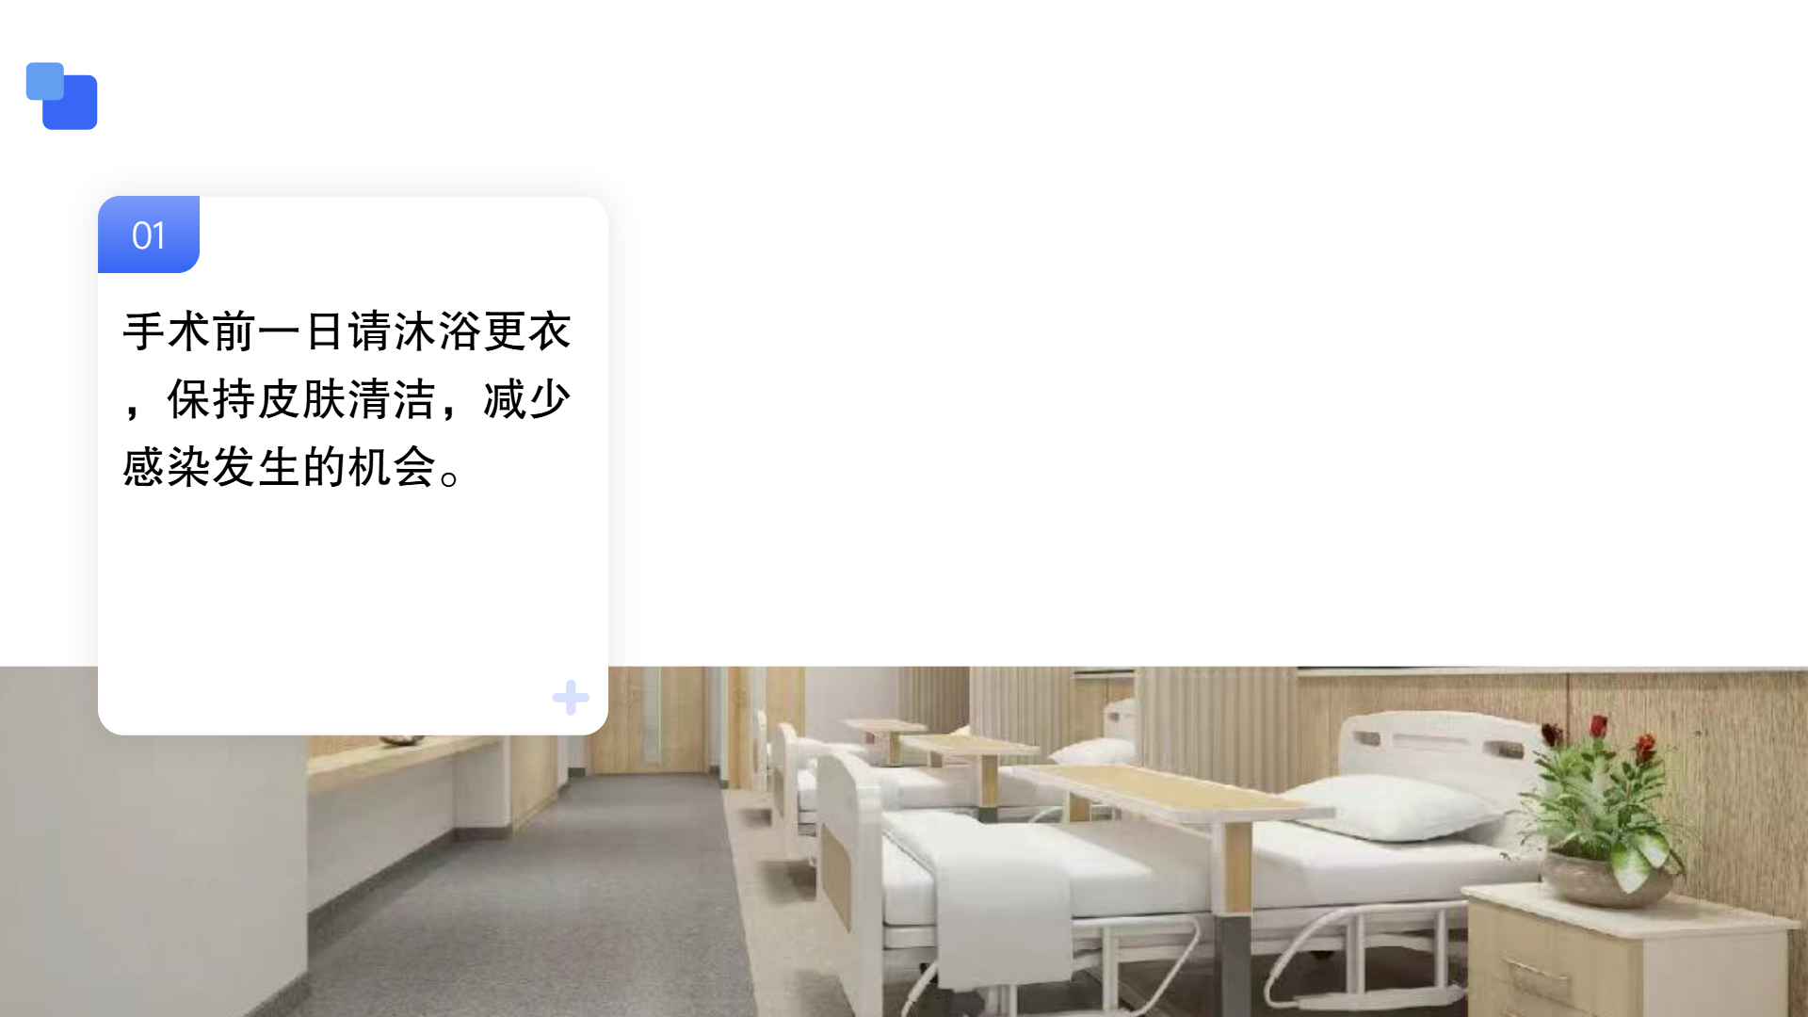
Please take a bath and change clothes the day before the operation to keep your skin clean and reduce the chance of infection
Notes:
第二，成人病员要于手术前12小时禁食、6小时禁饮。手术当日早晨不能进食任何食物和水包括牛奶，婴幼儿及特殊情况请听从医师指导。

Slide 2
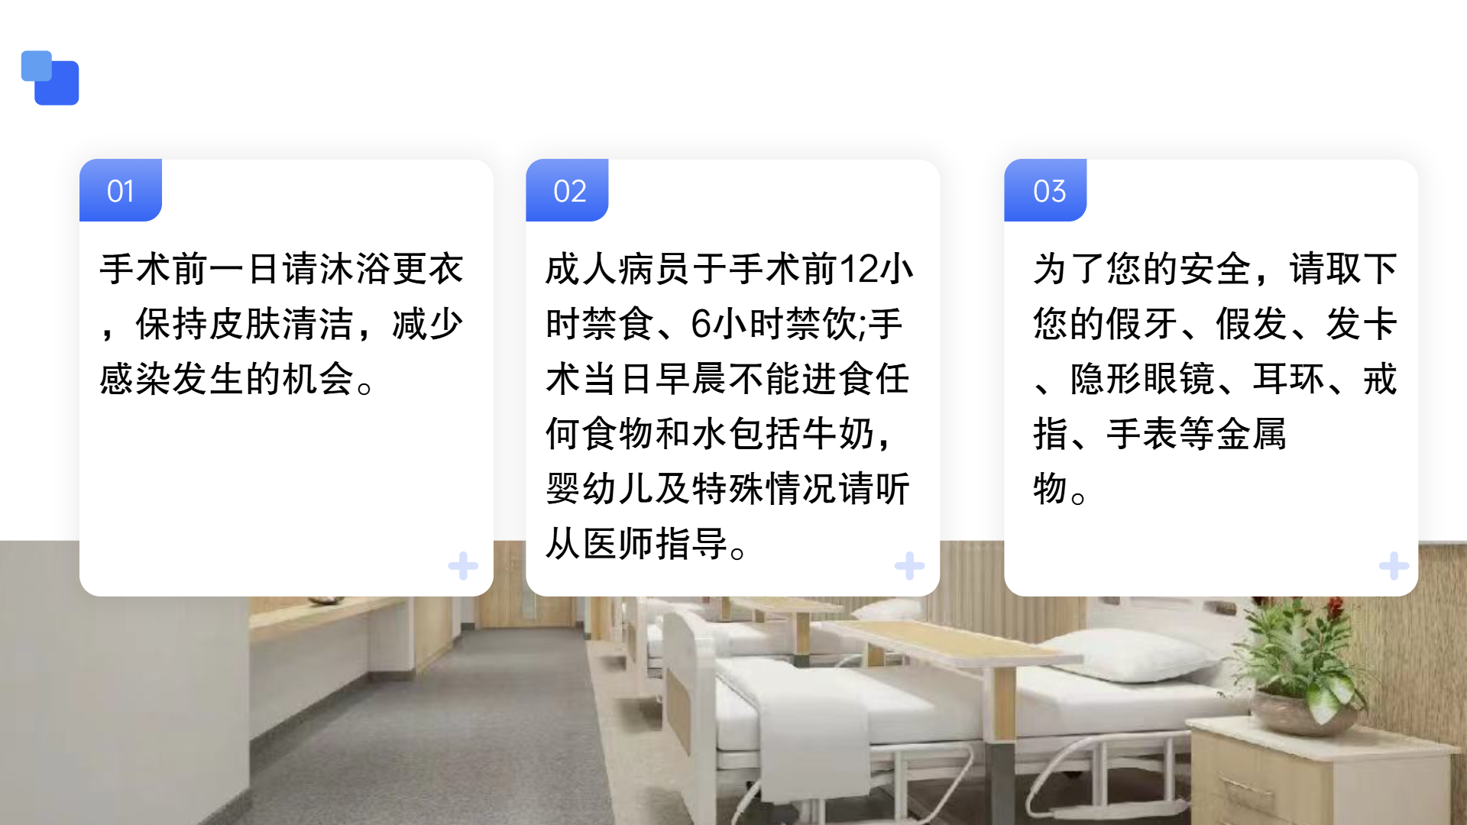
Please take a bath and change clothes the day before the operation to keep your skin clean and reduce the chance of infection
Adult patients must fast for 12 hours and abstain from liquids for 6 hours prior to surgery. No food, water, or milk of any kind is allowed on the morning of the operation. For infants, young children and special cases, please follow the doctor’s instructions.
For your safety, please remove your dentures, wigs, hairpins, contact lenses, earrings, rings, watches and other metallic items.
Notes:
第三，为了您的安全，请取下您的假牙、假发、隐形眼镜、耳环、戒指、手表等金属物，以免干扰仪器运作。

Slide 3
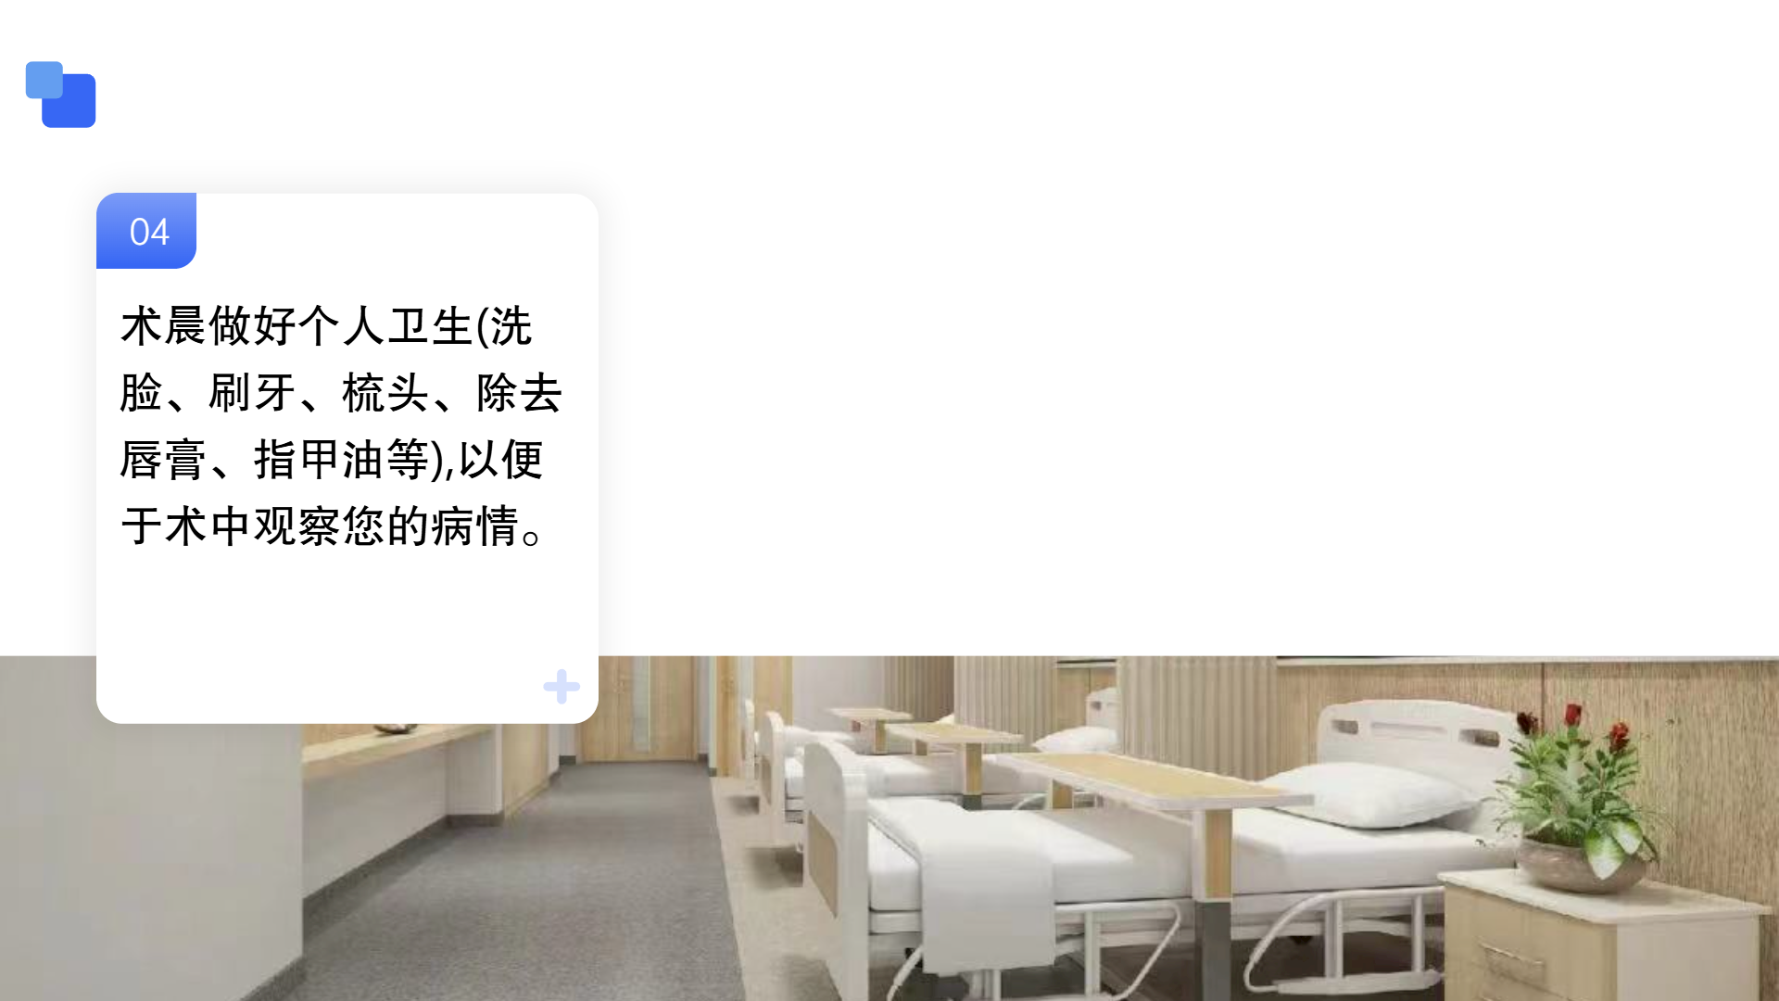
Please take care of personal hygiene on the morning of surgery (including face washing, tooth brushing, hair combing, and removal of lipstick and nail polish) to facilitate the observation of your condition during the operation.
Notes:
第四，术晨要做好个人卫生，洗脸、刷牙、梳头、除去唇膏、指甲油等,以便于术中观察您的病情。

Slide 4
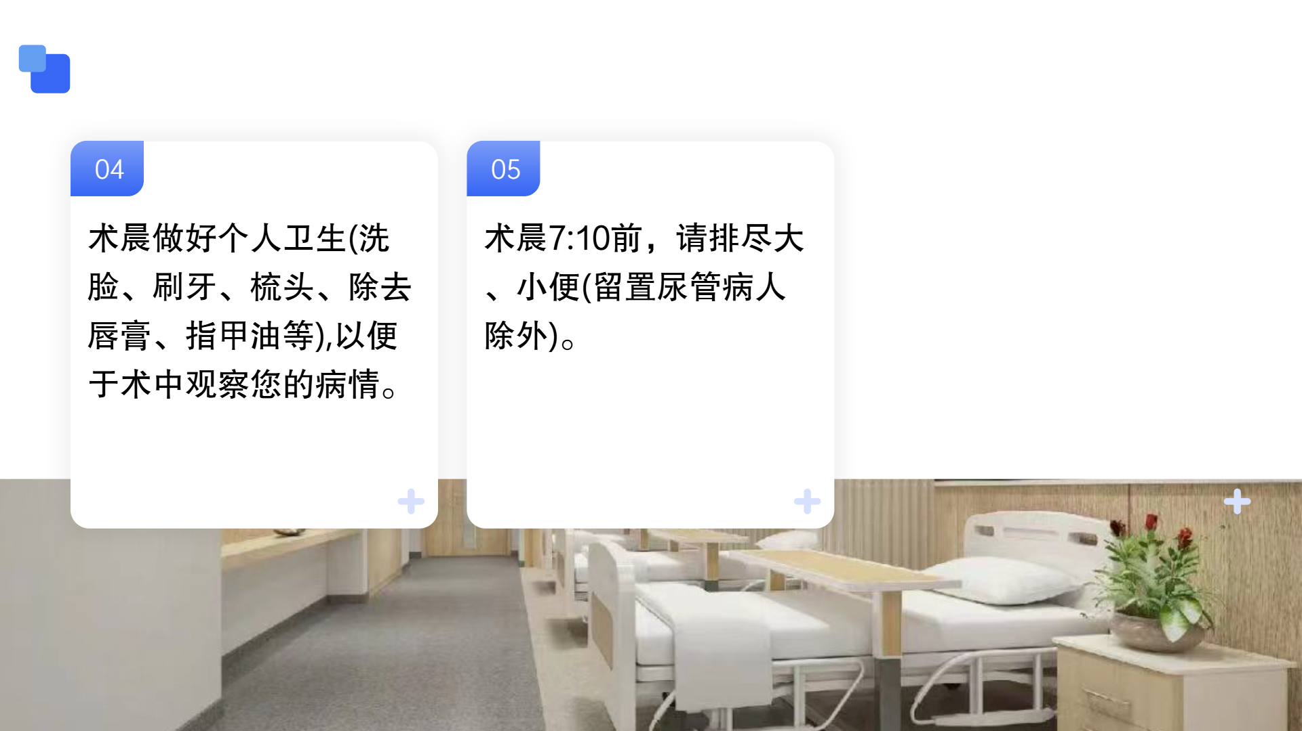
Please take care of personal hygiene on the morning of surgery (including face washing, tooth brushing, hair combing, and removal of lipstick and nail polish) to facilitate the observation of your condition during the operation.
Please empty your bowels and bladder before 7:10 on the morning of the operation (except for patients with indwelling urinary catheters).

Slide 5
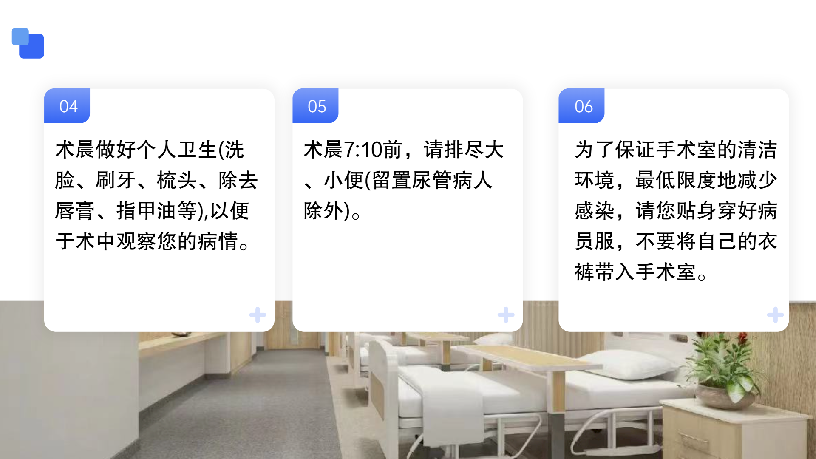
Please take care of personal hygiene on the morning of surgery (including face washing, tooth brushing, hair combing, and removal of lipstick and nail polish) to facilitate the observation of your condition during the operation.
Please empty your bowels and bladder before 7:10 on the morning of the operation (except for patients with indwelling urinary catheters).
Sixth, to maintain a clean environment in the operating room and minimize the risk of infection, , please wear the patient gown next to your skin and do not bring your own clothes or pants into the operating room.

